Slide 1

Jubecer Client and Security Guards Management System

Slide 2

Introduction
Jubecer Security Service, Inc. is an organization, which provides armed security services and expertise to private and public clients. They deploy trustworthy and well trained securities to protect establishments. They provide high quality security service to clients. They also employ security and lady guards and train them to be fit to line of work.

Slide 3

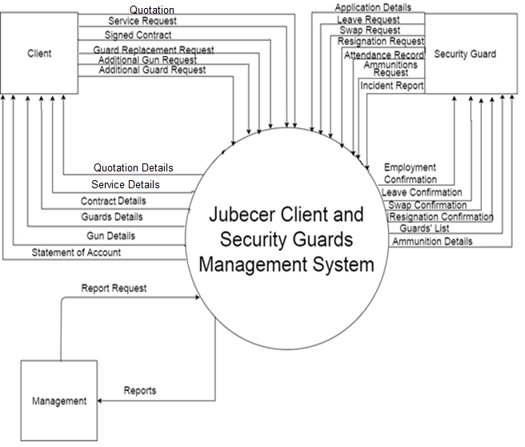
Context Diagram

Slide 4
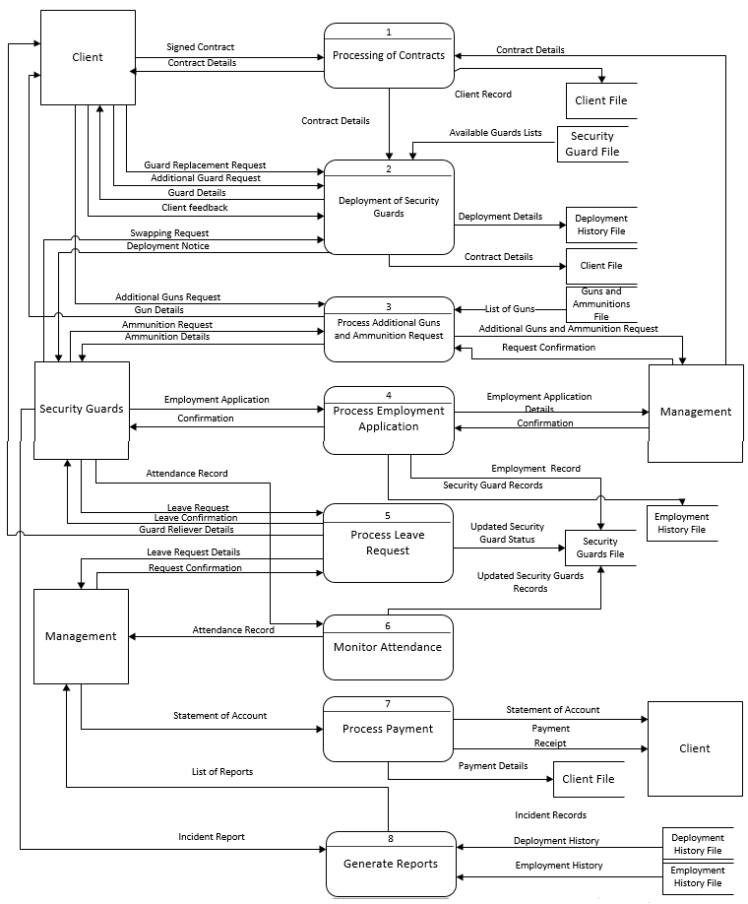
DFD

Slide 5
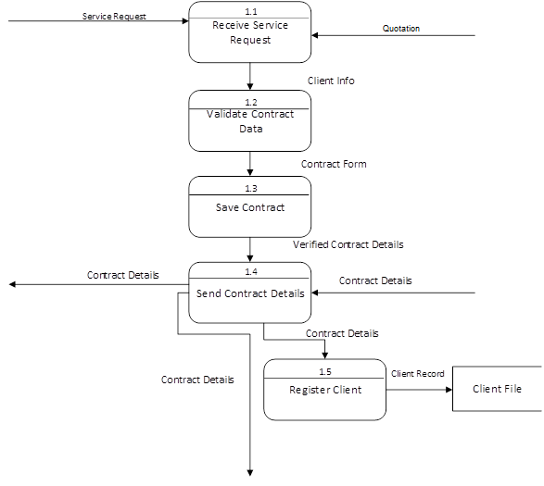
Client Registration/Processing of Contracts

Slide 6
Deployment of Security Guards

Slide 7
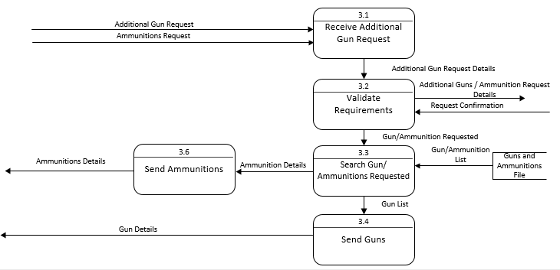
Ammunition Request

Slide 8
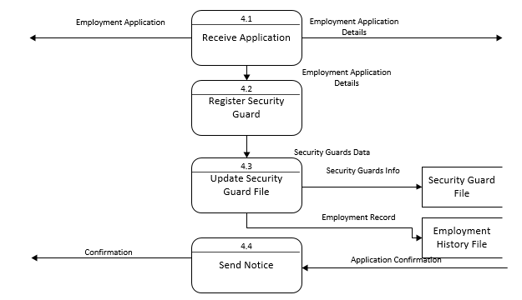
Process Employment Application

Slide 9
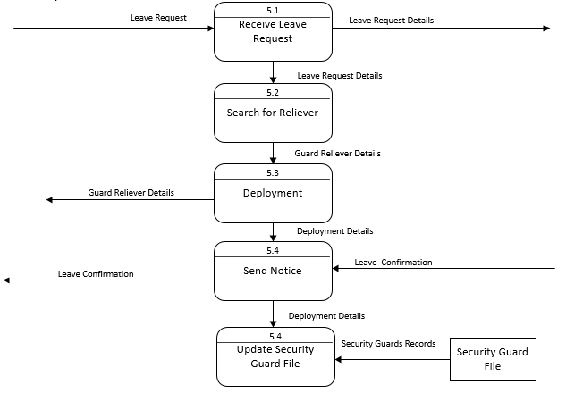
Leave Request

Slide 10
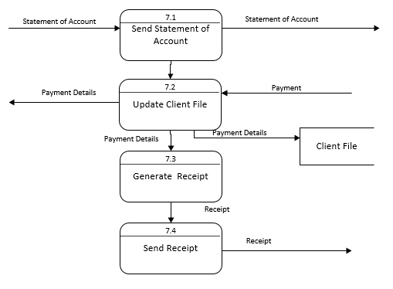
Blling and Collection

Slide 11
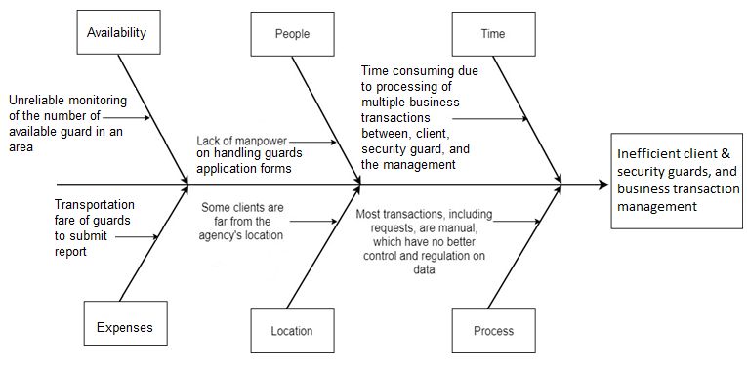
Fishbone

Slide 12
Fishbone

Slide 13
Fishbone

Slide 14
Fishbone

Slide 15
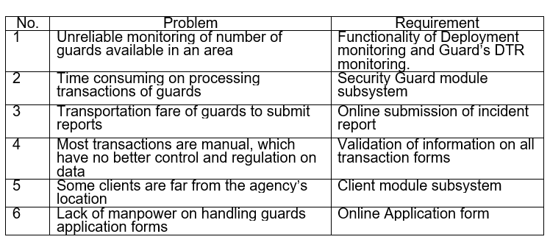
Problem & Requirements

Slide 16
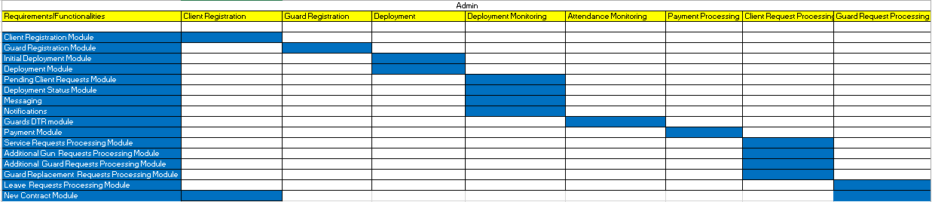
Requirements-Features Matrix

Slide 17
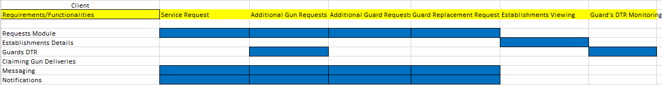

Slide 18
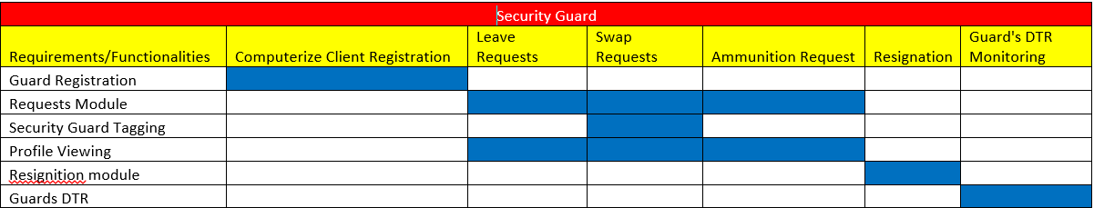

Slide 19
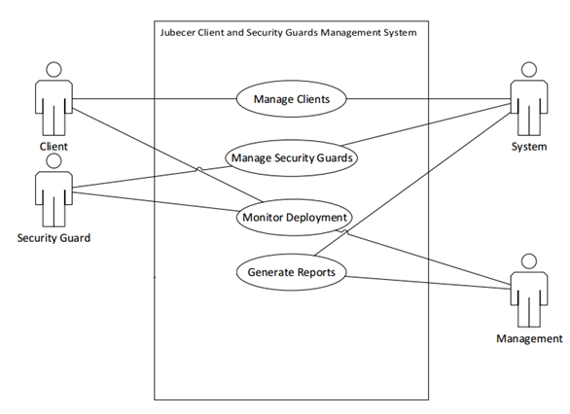
Use Case

Slide 20
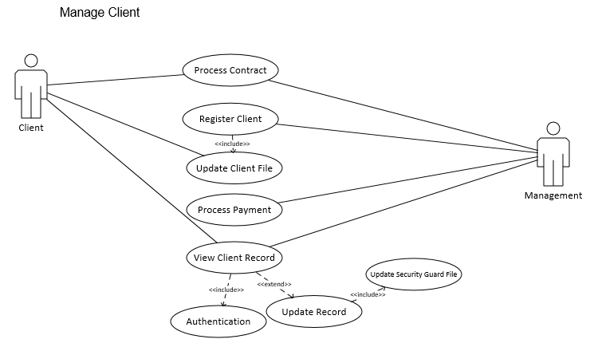
Detailed per Use Case

Slide 21
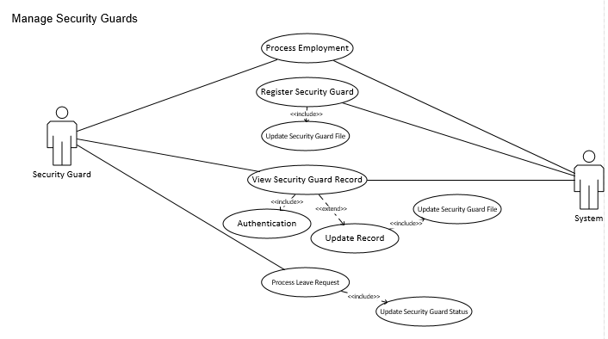

Slide 22
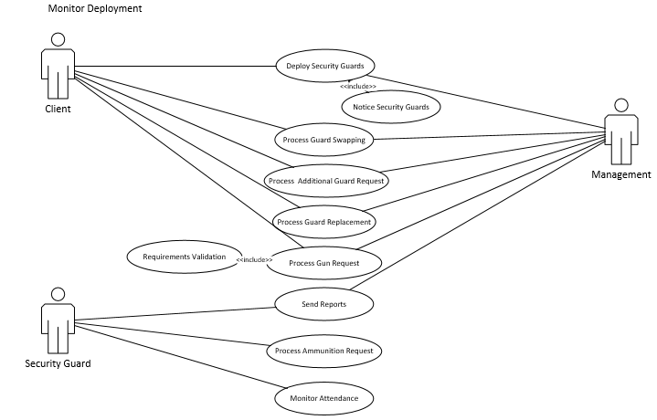

Slide 23
